Slide 1
The Lognormal Distribution
And its Applications in Finance

Slide 2

What is the Lognormal Distribution?
A Lognormal Distribution is a continuous distribution of a random variable whose logarithm is normally distributed
In other words, X is lognormally distributed if Y=ln(X) is normally distributed
The Probability Density function of the lognormal distribution is as follows:
  $f\left(x\right)=\frac{1}{\sqrt{2π}σx}e^{−(\ln\left(x\right)−{μ)}^{2}/2σ^{2} }$
  It can be derived directly from the normal distribution by considering a lognormal distribution X and a normal distribution Y and letting X=$e^{Y}$=g(Y)
  Y=ln(X)=$g^{−1}(X)$
  The derivative of $g^{−1}(X)$ (the Jacobian) with respect to X is $\frac{1}{X}$
  T$hus, f_{X}\left(X\right)=f_{Y}\left[\ln\left(X\right)\right]∗$ $\frac{1}{X}$, which is equal to the lognormal distribution above

Slide 3

What is the Lognormal Distribution (cont.)
The CDF derived from that is F(x)=$\frac{1}{\sqrt{2π}σ}\int_{0}^{∞}{\frac{e^{\frac{−(\ln\left(x\right)−μ)^{2}}{2σ^{2}}}}{x}dx}$
I couldn’t simplify this term because there was an “error function” when I took this integral
The M.G.F. is only useful on the interval (-∞,0), so to find the mean later I will use the M.G.F. for the normal distribution
Here is an example of a lognormal curve:

Slide 4
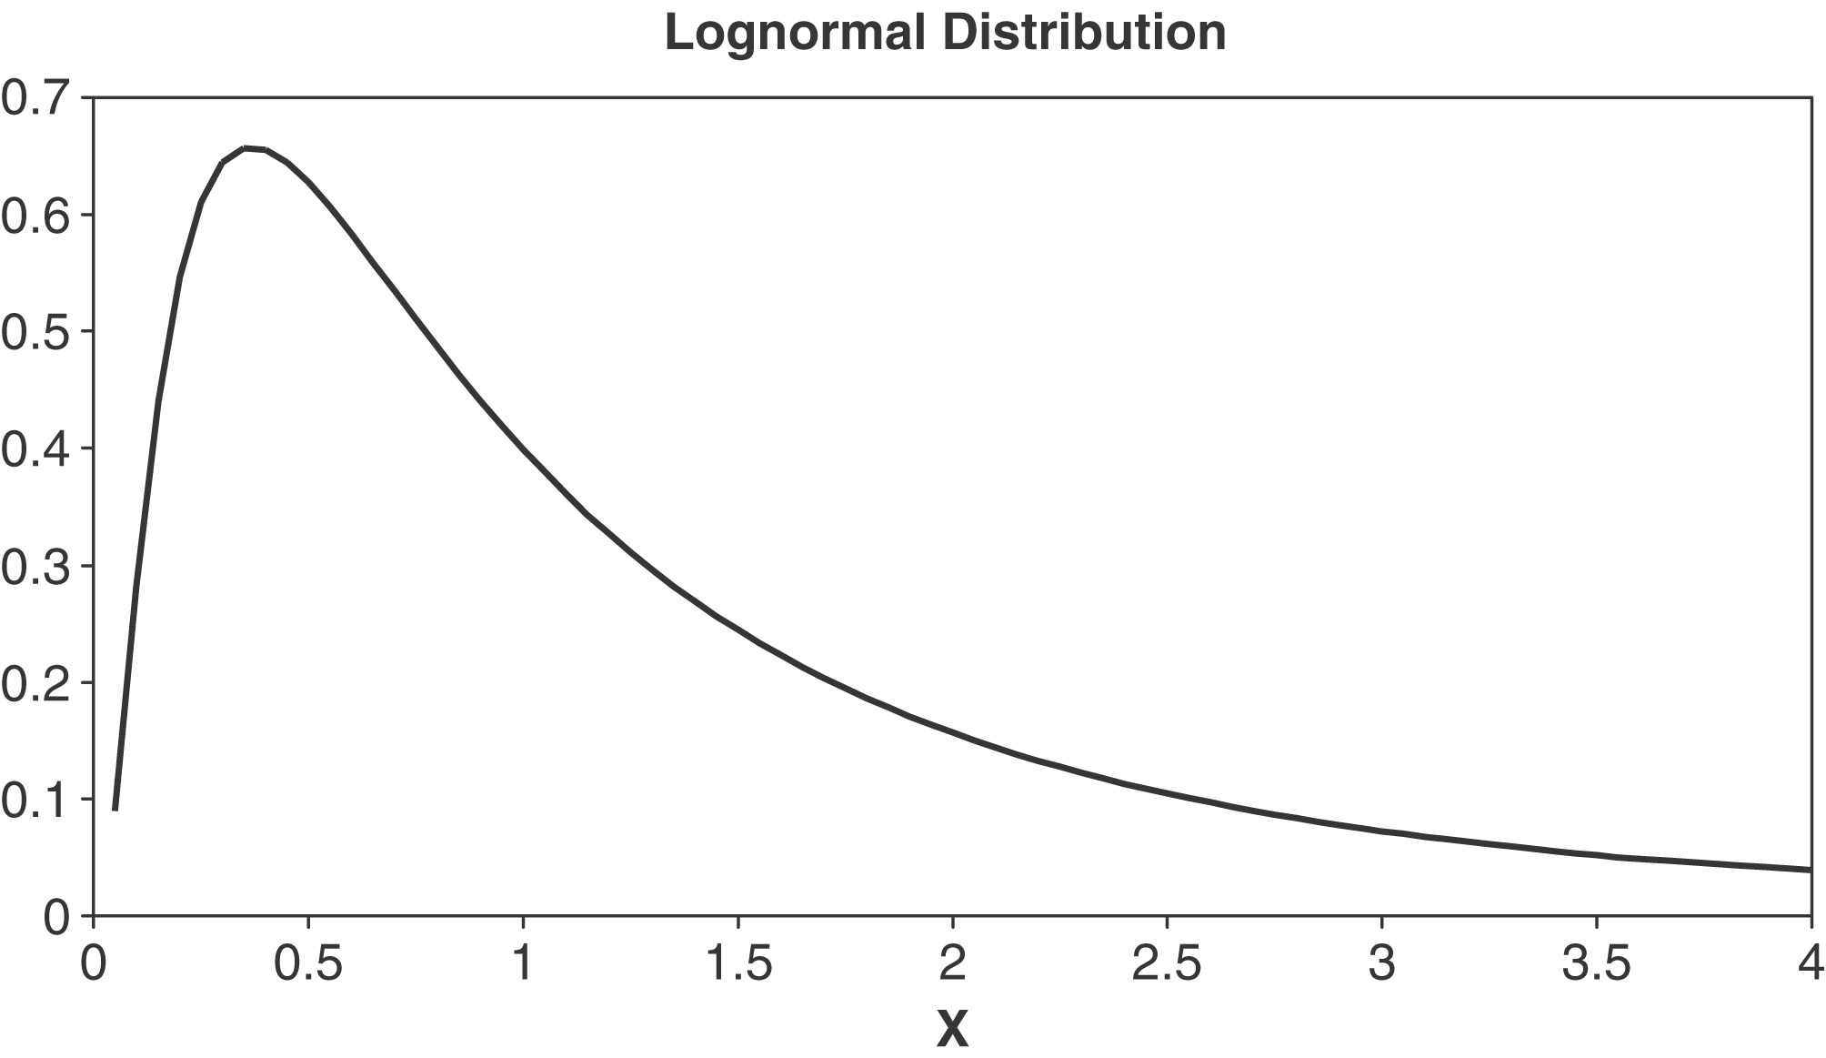

Slide 5
History of the Lognormal Distribution
“Galton (1879) and McAlister (1879) Initiated the study of the distribution in papers published together, relating it to the use of the geometric mean as an estimate of location.
“Much later Kapteyn (1903) discussed the genesis of the distribution, and Kapteyn and Van Uven (1916) gave a graphical method for estimating parameters.”¹
There were other statisticians, like Pearson, who had a “general mistrust of the technique of transformation.”²
Though the lognormal distribution should be used carefully, hopefully I can show in this presentation that it is incredibly valuable specifically for estimation purposes in finance.

Slide 6

Finding the Mean and Variance
Let Y be a normally distributed function.
Thus, it’s moment generating function is $e^{μt+\frac{σ^{2}t^{2}}{2}}=E\left[e^{tX}\right]$
Let X be a lognormally distributed function such that $e^{Y}=X$
Thus, since the mean of X is equal to E[X], the mean of X is also equal to E[$e^{Y}$] which is the t=1 moment of Y.
Thus, the mean of X is:
  $e^{μ\left(1\right)+\frac{σ^{2}{\left(1\right)}^{2}}{2}=}e^{μ+\frac{σ^{2}}{2}}$
Likewise, the variance of X is:
  $M_{Y}\left(2\right)−$ $M_{Y}\left(1\right)$²=$e^{2μ+\frac{σ^{2}∗4}{2}}$-$(e^{μ+\frac{σ^{2}}{2}})^{2}\text{=} e^{2μ+2σ^{2}}\text{−}e^{2μ+σ^{2}}$

Slide 7

Why do we care about the Lognormal?
So why do we bother with this transformation when we know so much more about the normal curve than the lognormal curve?
Here is a great and simple example of the use of the lognormal curve for modeling stock prices over time:
  “Suppose that the price of a stock or other asset at time 0 is known to be S(0) and we want to model its future price S(10) at time 10—note that some texts use the notation S₀ and S₁₀ instead. Let’s break the time interval from 0 to 10 into 10,000 pieces of length 0.001, and let’s let S_{k} stand for S(0.001k), the price at time 0.001k. I know the price S₀ = S(0) and want to model the price S₁₀₀₀₀ = S(10). I can write:
  (1.1) S(10)= S₁₀₀₀₀ =$\frac{S_{10000}}{S_{9999}}∙\frac{S_{9999}}{S_{9998}}…\frac{S_{2}}{S_{1}}∙\frac{S_{1}}{S_{0}}∙S_{0}$

Slide 8

Example (cont.)
Now suppose that the ratios R_{k} =S_{k}/S_{k−1} that appear in Equation 1.1 that represent the growth factors in price over each interval of length 0.001 are random variables, and—to get a simple model—are all independent of one another. Then Equation 1.1 writes S(10) as a product of a large number of independent random variables R_{k}. You know from probability that the sum of a large number of random variables W_{k} can, under reasonable hypotheses, be approximated well by a Normal random variable with the same mean and variance as the sum. Unfortunately Equation 1.1 involves a product, not a sum. But if we take the natural log of both sides, we get:
(1.2) ln S₁₀₀₀₀ = ln R₁₀₀₀₀ + ln R₉₉₉₉ + · · · + ln R₂ + ln R₁ + ln S₀.”³
This means that, if we reasonable assume that all of these R_{k}s have the same probability distributions with positive variance, we can predict the log of S(10) as ln(S₀)+N(10000μ,10000$σ^{2})$

Slide 9

Example (cont.)
Thus, we can model S(10) as S(0) times a lognormal random variable parameters 10000μ and 10000$σ^{2}.$
In fact, we can generalize this to S(t) and apply it over an even greater period of time to predict stock prices
Essentially, the usefulness of the lognormal distribution in this example is to turn a large product of random variables into a sum

Slide 10
The Catch
Though the lognormal distribution is incredibly effective for calculating the product of many small independent random factors, there are certainly some drawbacks
  A normal distribution can work for all real numbers whereas a lognormal distribution can only apply to positive real numbers
  2. A normal distribution is symmetric which provides a lot of important properties, the lognormal is skewed
  3. And finally, the lognormal numbers are less easily intuitively interpreted than the numbers generated by a normal distribution

Slide 11
Sources
“Lognormal Distributions: Theory and Applications”, Volume 88 of Statistics: A Series of Textbooks and Monographs, ed. Edwin L. Crow and Kunio Shimizu. (CRC Press), 1988.
The Lognormal Distribution, http://books.google.com/books?id=Kus8AAAAIAAJ
LogNormal stock-price models in Exams MFE/3 and C/4, James W. Daniel, http://www.actuarialseminars.com/Misc/Lognormal.pdf, (Austin: Actuarial Seminars), 2008.
Geske, Teri. On the Edge, http://www.bondedge.com/us/fi_articles/fi_subtleties_considerations.html, 2007.

